Slide 1
Exam #3 Review
Summer 2015
Topical Coverage: Lessons 14-20 (convolution/state space)
Exam #3 Monday
Turn in Project #3 today.
Exam #3 Review

Slide 2
Challenge 20 – Not Graded
An FIR has an impulse response h[k]={1, ½, ¼, 1/8} and an input segment {x[k]}. The input signal x[k]={x[0],x[1],x[2],x[3]} is coded as 4-bit 2’s complement (2C) words having a [4:3] format. The filter is implemented as a distributed arithmetic (DA) filter. Analyze for:
x[0] = 0.75 = 0 1 1 0
x[1] = -0.5 = 1 1 0 0
x[2] = 0.25 = 0 0 1 0
x[3] = -0.125 = 1 1 1 1
Sidebar y[3] = h[0]x[3]+h[1]x[2]+h[2]x[1]+h[3]x[0] = -2/64
-1 ½ ¼ 1/8 Bit weights
Exam #3 Review

Slide 3
±210
0 0000 0
0001 1
0010 0.5
0011 1.5
0100 0.25
0101 1.25
0110 0.75
0111 1.75
1000 0.125
1001 1.125
1010 0.625
1011 1.625
1100 0.375
1101 1.375
1110 0.875
1111 1.875
h[0]=1
h[1]=1/2
h[0]+h[1]=3/2
h[2]=1/4
h[k]={1, ½, ¼, 1/8}
h[3]=1/8
h[0]+h[3]=5/4
Examples
LUT data entries
Exam #3 Review

Slide 4
x[0] = 0.75 = 0 1 1 0 _{2C} h[3] = 1/8
x[1] = -0.5 = 1 1 0 0 _{2C} h[2] = 1/4
x[2] = 0.25 = 0 0 1 0 _{2C} h[1] = 1/2
x[3] = -0.125 = 1 1 1 1 _{2C} h[0] = 1
LUT[0]=h[0]=64/64
LUT[1]= h[0]+h[1]+h[3]=104/64
LUT[2]= h[0]+h[2]+h[3]=88/64
LUT[3]= h[0]+h[2]=80/64
±  3 2 1 Bit index
LUT
4- bit input addresses 4-LUT outputs
Exam #3 Review

Slide 5
DA Architecture
X[0]
LUT (ROM)
+/-
k ±q y z
0 64/64 0 64/64
1 104/64 32/64 136/64
88/64 68/64 156/64
3 -80/64 78/64 -2/64
X[1]
q
⊕
z
y
X[2]
1/2
X[3]
Agreement
LUT outputs
Exam #3 Review

Slide 6
Practice Exam #3
Exam #3 Review

Slide 7
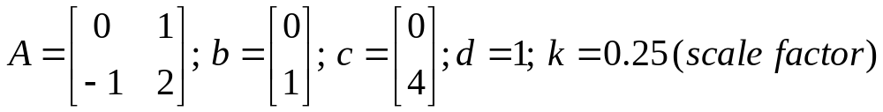
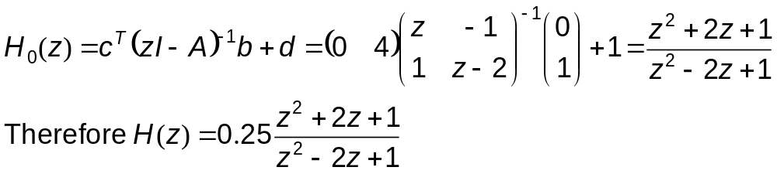
Problem 1: State Space
A 2nd order LTI system has a transfer function H(z)=k H₀(z), where k=0.25 and H₀(z) has the state 4-tuple representation of an alternative traditionally ordered Direct II filter given by:
a. What is the system’s transfer function H(z)?
Exam #3 Review

Slide 8
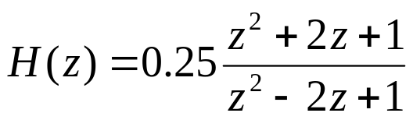
Problem 1: State Space
b. Is the system stable?
Poles are repeated at z = -1. Therefore system is unstable.
Exam #3 Review

Slide 9
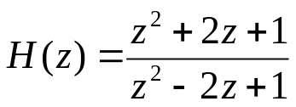
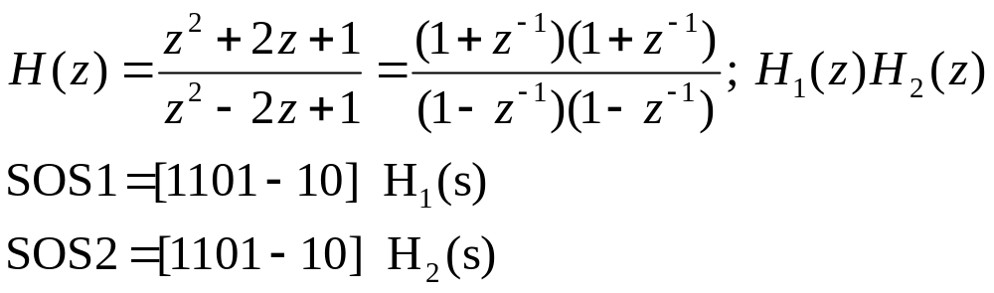
Problem 1: State Space
c. Suppose H(z) from part 1.a is:
Represent H(z) as a cascaded filter consisting of 2 1st order sections in an SOS (MATLAB) format.
Factoring in descending order:
Exam #3 Review

Slide 10

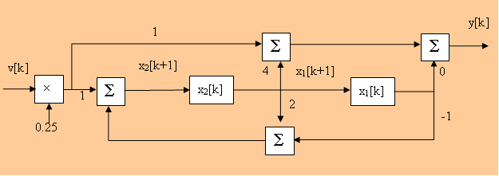
Problem 1: State Space
d. Based on the given state 4-tuple (Q1.a), sketch the traditionally ordered alternative Direct II implementation of H(z). Show all non-zero multipliers, adders, and shift registers along with their interconnections. Identify which shift registers store state x₁ and x₂.
Exam #3 Review

Slide 11
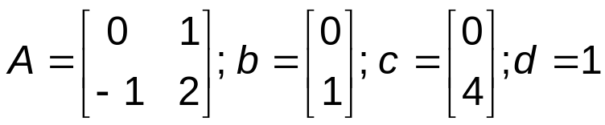
Problem 2: State Space
Suppose an LTI system has a transfer function H(z)=(z²+2z+1)/ (z²-2z+1). Determine the traditionally ordered alternative Direct II 4-tuple [A,b,c,d] representation of H(z).
Have H(z)= (z²+2z¹+1)/ (z²-2z¹+1)=
(descending) = (1+2z⁻¹+ z⁻²) / (1-2z⁻¹+ z⁻²)
{divide} = 1 + ((4z⁻¹)/ (1-2z⁻¹+ z⁻²)).
Therefore:
Exam #3 Review

Slide 12
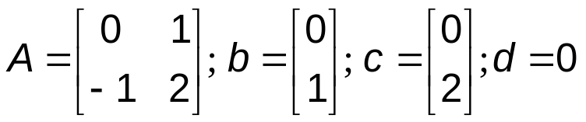
Problem 2: State Space
b. Suppose the LTI’s state model is defined by
Sketch the filter’s alternative traditionally ordered Direct II architecture and indicate the location of states x₁ and x₂.
⊕
⊕
y[k]
0
2
0
v[k]
⊕
x₂[k]
x₁[k]
2
-1
⊕
Exam #3 Review

Slide 13
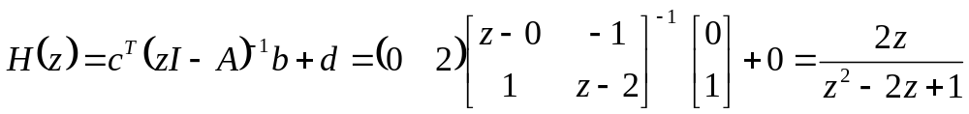
Problem 2: State Space
c. What is the LTI system’s input-output transfer function of the system described in problem 2.b?
Exam #3 Review

Slide 14
Problem 2: State Space
d. Suppose the transfer function between the input and state location x₂[k] is H(z)=z/(z+0.8) (1st order). What is impulse response measured at state location x₂[k]?
Legacy knowledge
x₂[k]=(-0.8)^{k} = {1, -0.8, +0.64 + …}
Remember, some z-transform operations are interpreted in ascending order, others in descending order.
Exam #3 Review

Slide 15
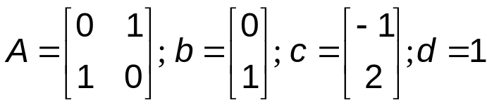
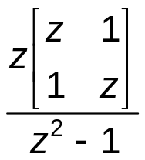
Problem 3: State Space
Suppose the traditionally ordered alternative Direct II state variable representation of H(z) is:
What is the z-transform of the state transition matrix Φ[k]=A^{k} (i.e., Φ(z))
Φ[z]=z(zI-A)⁻¹=
Exam #3 Review

Slide 16
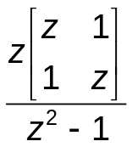
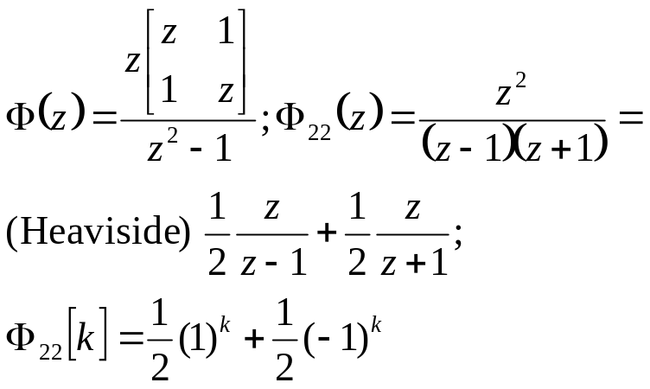
Problem 3: State Space
Suppose the answer to Part 3.a is Φ(z)= .
What then is Φ₂₂[k]?
or Φ₂₂[k] = {1,0,1,0,1,0, … }.
Exam #3 Review

Slide 17
Problem 4: Convolution
Given an impulse response h[k] = [1,2,3] and signal x[k]=[0,1,2].
a. What is the convolution length (linear and circular) of y[k]=h[k]∗x[k] and y[k]=h[k]⊗x[k] in samples?
Linear (3+3-1)=5 samples
Circular = 3
Exam #3 Review

Slide 18
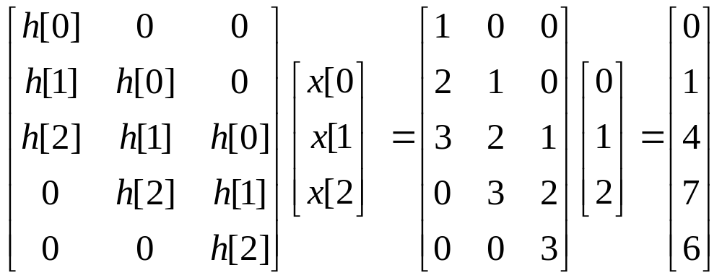
Problem 4: Convolution
b. What is the linear convolution y[k]=h[k]*x[k]?
3x5 matrix
2 samples in transient build-up
2 samples in transient build-down
1 samples in steady-state
Exam #3 Review

Slide 19
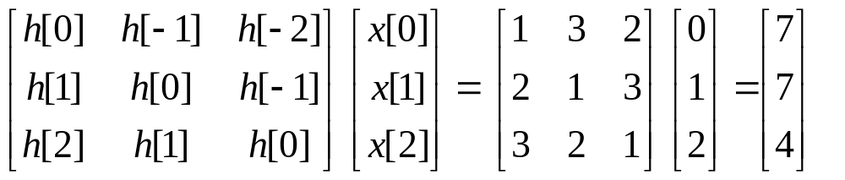
Problem 4: Convolution
c. What is the circular convolution y[k]=h[k]⊗x[k]?
3x3 matrix
Exam #3 Review

Slide 20
Problem 4: Convolution
d. Suppose h[k]={1, ½, ¼, 1/8}, what is the filter’s Direct implementation in block diagram form? Use the template provided.
T
T
T
1
1/2
1/4
1/8
Σ
Σ
Σ
Exam #3 Review

Slide 21
Problem 5: Convolution
A signal and discrete-time system’s impulse response is given by
x[k] = {0,1,0,1} and h[k] = {1,0,-1}.
What is the linear convolution y[k]=h[k]∗x[k] and Y(z) using the convolution theorem in the z-domain?
X(z)=z⁻¹+z⁻³
H(z)= 1- z⁻²
X(z)H(z)=Y(z)= z⁻¹ - z⁻⁵
Therefore, from legacy knowledge,
y[k]={0, 1,0, 0, 0, -1, … }
Exam #3 Review

Slide 22
Problem 5: Convolution
b. Suppose x[k]=u[k], k∈[0,99] and h[k]=u[k], k∈[0,4]. What is the length of their linear convolution (y[k]=h[k]∗x[k]) in samples
L=100+5-1=104.
Exam #3 Review

Slide 23
Problem 5: Convolution
c. A radix-2 FFT is to be used to perform the linear convolution. What is the smallest radix-2 FFT that can be used and how many zeros would you need to pad to x[k] and h[k]? (do not use any overlap method)
L=104
N(FFT)=128>104 (smallest radix-2 FFT length)
Pad x[k] with 128-100=28 zeros
Pad h[k] with 128-5=123 zeros
Exam #3 Review

Slide 24
Exam #3 Comments
Open notes and text.
No Internet connection except to Sakai and MATLAB.
Do not rely on MATLAB!
Topics:
Linear convolution, convolution theorem, circular convolution, overlap and add.
State modeling, state transition matrix, state defined architectures (Direct II, cascade, parallel, and FIR).
No distributed arithmetic or canonic signed digit or overlap and add.
“Chance favors the prepared mind.” – Louis Pasteur
Exam #3 Review

